Slide 1
Async Masterclass
Way more than you ever wanted to know. Unless you have an insatiable thirst for knowledge.
In which case, this is just one well on your journey.
Notes:
Thank you for coming to my Thread Talk!
Litmus test: you should already be familiar with TaskCompletionSource.

Slide 2
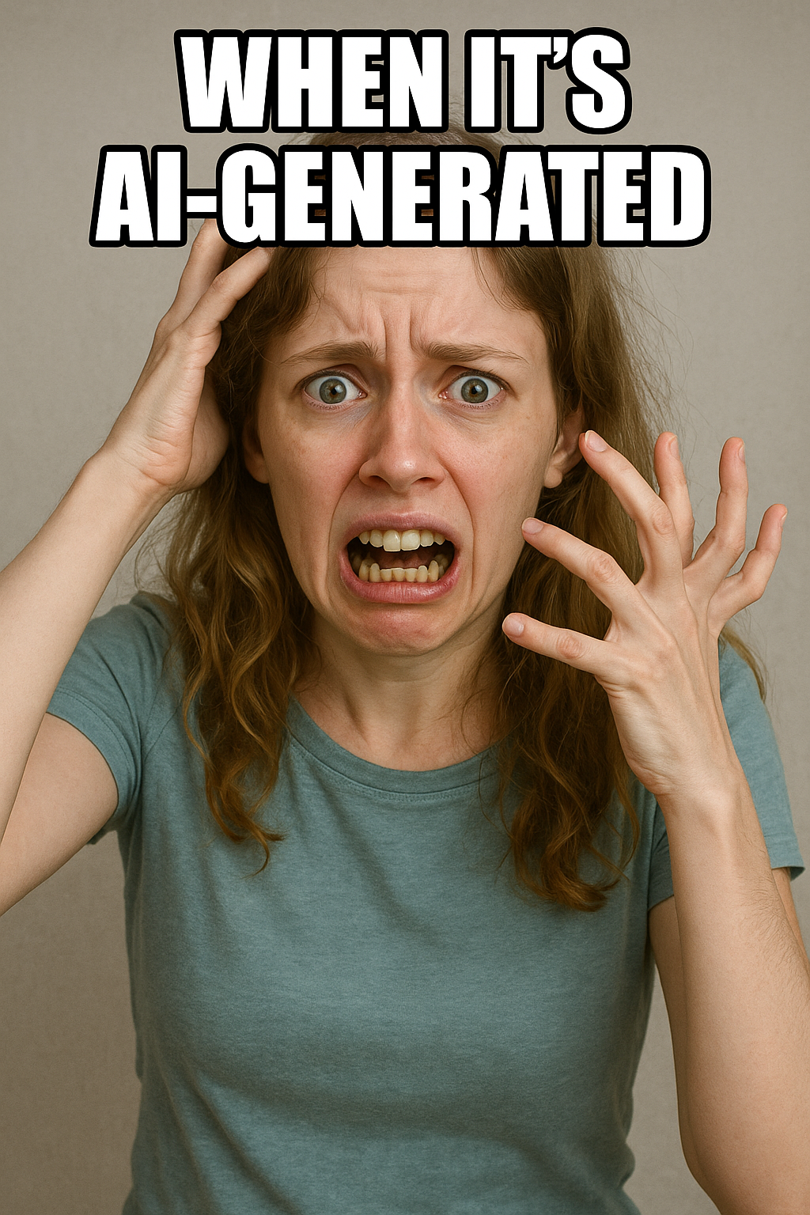

Who is this guy?
Notes:
Available for contract work!
Microsoft MVP
Top async/await answerer on Stack Overflow
Assisted hundreds of companies with async adoption across all kinds of applications (available for contract work!)
Blog has been the go-to source for async advice for years
Contributor of some of the MS documentation on subjects such as ValueTask
Maintainer of AsyncEx, a library with >25M downloads which provides asynchronous coordination primitives and other async helper types (pretty much the subject of today’s talk)

Slide 3


Slide 4
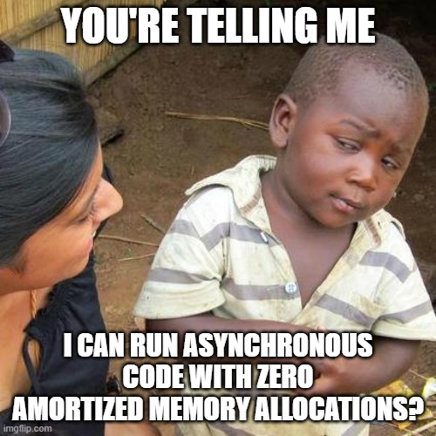
ValueTask

Slide 5
ValueTask History
High-performance code that needs to reduce allocations.
Classic use case: Socket.
First ValueTask was either a synchronous result or Task.
Modern ValueTask can also be an IValueTaskSource (enables pooled / recycled source instances – essentially a reusable Task).
https://tinyurl.com/value-task
Notes:
Socket: APM, SocketAsyncEventArgs, TAP, ValueTask

Slide 6
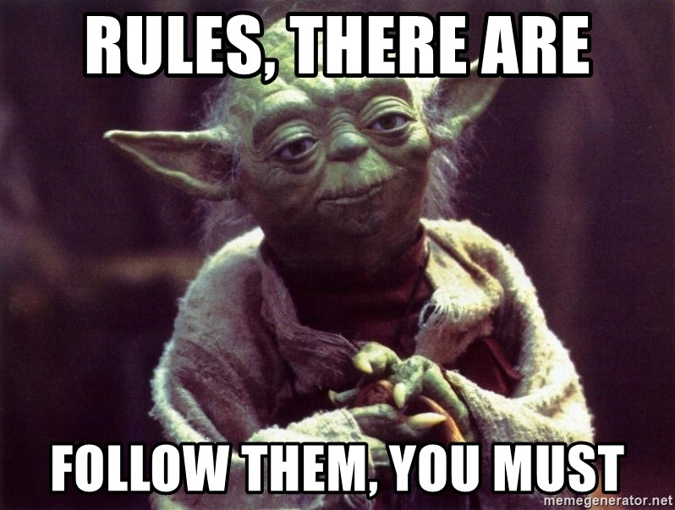
Rules Around ValueTask
Only consume once!
await – the 99% case.
Advanced: IsCompleted for fast path.
Cannot block!
.Result and .GetAwaiter().GetResult() will compile but may fail at runtime.
Even worse, they may work at runtime (block) and then later fail at runtime.
Need to bend the rules? AsTask()

Slide 7
Implementing ValueTask Methods
Producing ValueTasks:
async ValueTask: possibly-synchronous results (.NET Core 1.1).
[AsyncMethodBuilder(typeof(PoolingAsyncValueTaskMethodBuilder<>))]: pooled ValueTask sources (.NET 6).
Mostly outdated:
Constructor: synchronous result or Task wrapper (.NET Core 1.0).
ManualResetValueTaskSourceCore<T> (.NET Core 3.0).
Implements IValueTaskSource<T>
Still useful for extremely performance-sensitive code, e.g., Socket reads/writes.

Slide 8
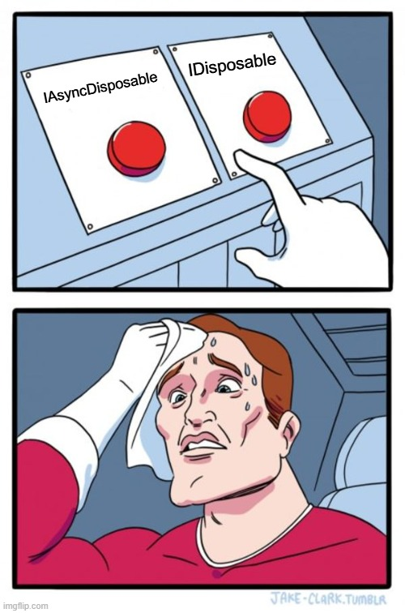
IAsyncDisposable

Slide 9
Asynchronous Disposal
ValueTask DisposeAsync();
Just like Dispose(), just asynchronous.
No official patterns for whether you can (or should) support both, “dispose pattern”, etc.
Not supported everywhere, e.g., AsyncServiceScope is 6.0+
Nito.Disposables if you want helpers.

Slide 10
Asynchronous Streams

Slide 11
Async Streams
Type | Usage
T | Synchronous, single value.
IEnumerable<T> | Synchronous, multiple values.
Task<T> | Asynchronous, single value.
IObservable<T> (or events) | Asynchronous, multiple values, pushed.
IAsyncEnumerable<T> | Asynchronous, multiple values, pulled.

Slide 12
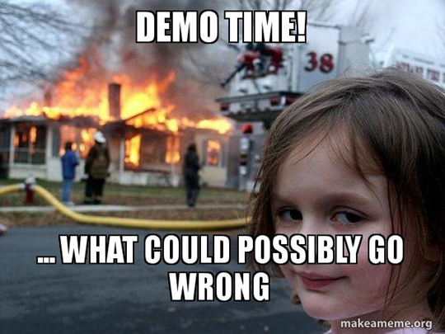
Notes:
Demo: 10-13 Shift-Alt-R

Slide 13
AsyncLocal<T>

Slide 14
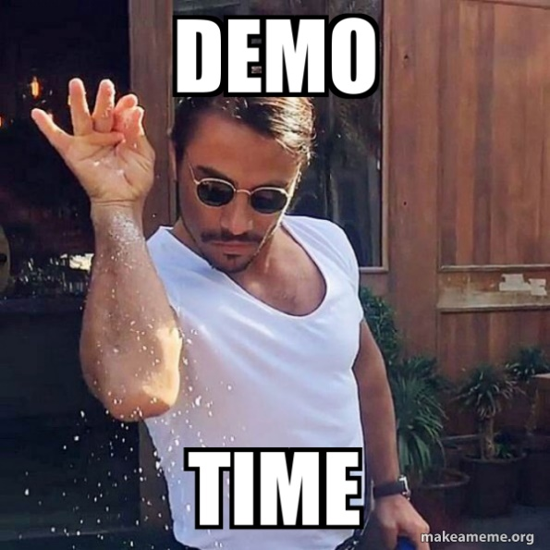
AsyncLocal
Implicit data with lexical scoping.
Notes:
20-21
Also show Task-returning method without async.

Slide 15
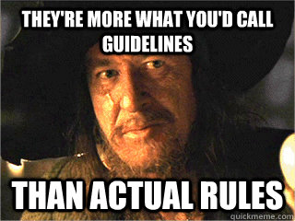
AsyncLocal: Guidelines
Use using to make scopes explicit.
Use immutable types.
There’s a difference between modifying the value and setting the value.
Use sparingly!
Implicit data is too magical. E.g., culture.
Similar drawbacks as global variables.
Notes:
Sparingly: Async cache items implicit option flow.

Slide 16
AsyncLocal: Details
Flowed by ExecutionContext
Pre-Core: part of LogicalCallContext vs IllogicalCallContext
Core: ExecutionContext
async methods shallow-copy their scope at beginning of method
Reason for immutable guideline.
Nested contexts, except every non-async method lives in its parent context (!)
Reason for using guideline.
Context always flows “down,” never “up”.
https://tinyurl.com/toub-async
https://tinyurl.com/asynclocal

Slide 17
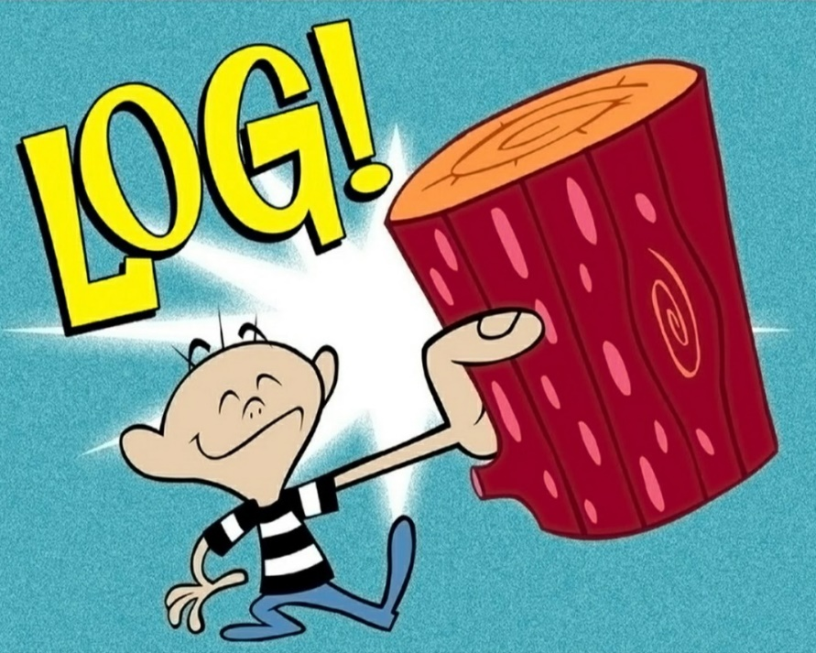
AsyncLocal: Primary Use Case
Attaching contextual data to log messages.

Slide 18
AsyncLocal: Primary Use Case: Pitfall
Exception logging missing contextual data.
How does ASP.NET middleware actually work?
How does exception logging middleware work?
Solution: throw context enrichers.

Slide 19
Channels

Slide 20
Channels: Async Producer/Consumer Queues
Replaces hand-grown or TPL Dataflow.
Consumer: ReadAllAsync.
Producer: WriteAsync + Complete.
Bounded for backpressure.

Slide 21
Notes:
30

Slide 22
PauseToken

Slide 23
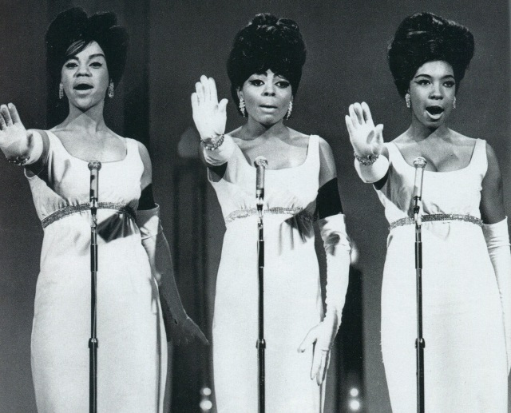
PauseToken: Desired Semantics
Pause / Unpause
WaitWhilePausedAsync
Can split into “source” (controller) and “token”, similar to CTS.

Slide 24
PauseToken: Recognized API Pattern
Similar to ManualResetEvent!
Event: A thing that is “signalled” or “unsignalled” and enables waiting for it to become signalled.
ManualReset: An event that is manually set (=> signalled) or reset (=> unsignalled).
Plan: build AsyncMRE first; then build PT+PTS.

Slide 25
PauseToken: Strategy
PauseToken Semantics | ManualResetEvent Semantics
Pause() | Reset()
Unpause() | Set()
WaitWhilePausedAsync() | WaitOne() /* Wait until set */

Slide 26
Notes:
40
Reset should use if (!_tcs.Task.IsCompleted)
Oops, there’s a bug!

Slide 27
PauseToken Implementation
Tricksy parts:
Never invoke end-user code while holding a lock.
TaskCompletionSource.TrySetResult (and friends) and CancellationTokenSource.Cancel are invocations of end-user code!

Slide 28
TCS Dictionary

Slide 29
TCS Dictionary: Desired Semantics
Common situation: multiple requests and replies, where replies may not be in request order.
Solution: TCS dictionary.
Operations: Insert, Remove-And-Complete.
Always complete your tasks!

Slide 31

TCS Dictionary: Worked Example
Building a TCP/IP client/server that uses ValueTask Socket methods, System.IO.Pipelines, Channels, and a TCS dictionary all together.
https://tinyurl.com/async-tcp

Slide 32
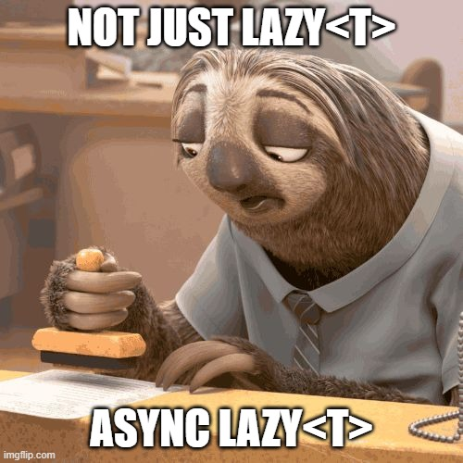
AsyncLazy<T>

Slide 33
AsyncLazy: Simplicity
Easy solution (Lazy<Task<T>> with GetAwaiter)
Notes:
private readonly Lazy<Task<T>> _lazy; public AsyncLazy(Func<Task<T>> func) => _lazy = new(func);
public TaskAwaiter<T> GetAwaiter() => _lazy.Value.GetAwaiter();

Slide 34
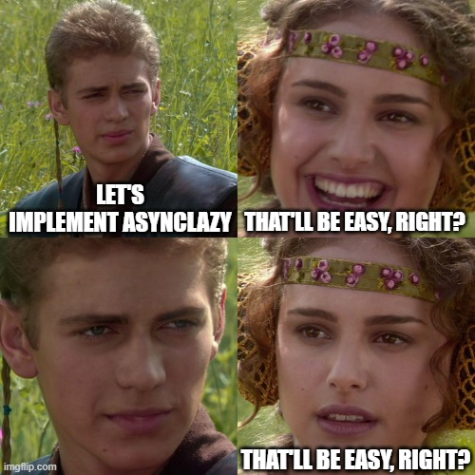
AsyncLazy: Complexity
Complex:
How to execute delegate?
Exceptions are cached.
(Non-async) Lazy<T> is weird here, too.
Should we also reset on demand?
At this point it becomes a single-item cache.
https://tinyurl.com/asynclazy-considerations
Notes:
.NET team didn’t implement AsyncLazy<T>. This means either A) They think I’m awesome because I already implemented it. B) They “back away slowly” and let that poor schmuck deal with it.
I don’t know which one it is, and at this point I’m too afraid to ask.

Slide 35
Async Caching

Slide 36
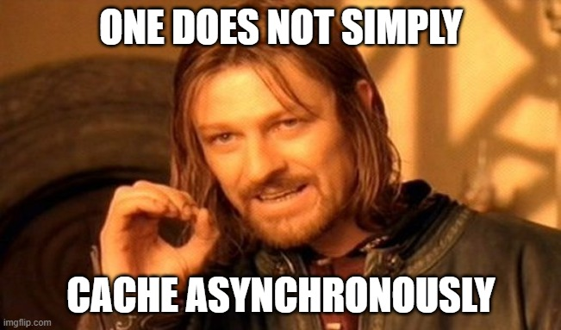
Asynchronous Caching.
Cache Task<T>, not its result.
IMemoryCache.GetOrCreateAsync exists but may not do what you want.
Must be in-memory. Task isn’t serializable in the general case.
! Similar problems as AsyncLazy<T>: caching exceptions.
! Removed/updated in cache before completed?
! Don’t know eviction parameters until completed? (JWT)
Solution: cache TaskCompletionSource<T>.
https://tinyurl.com/async-cache
Notes:
Warning: reviewed, but not load tested in prod.

Slide 37
Q&A

